Slide 1
Welcome to A Dog’s Life
-Operation hours
-Phone number
-Address
About
Home
Services
Career
Contact

Slide 2
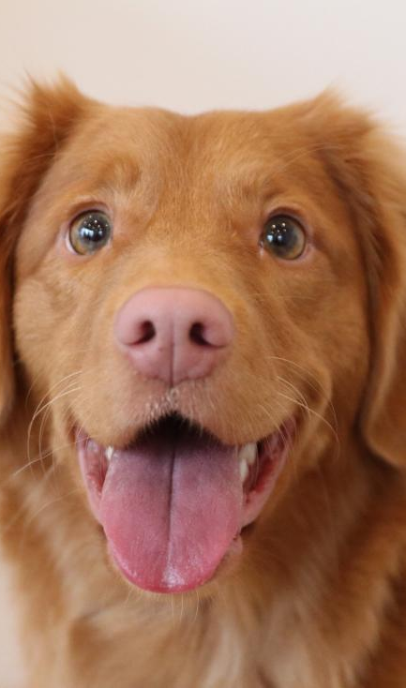
About Us Home About Services Career Contact
This is my first dog Max
I really love him
I want to take care of every dogs like how I took care of Max
Our mission is to make sure every dog looks beautiful leaving our salon

Slide 3
Services Home About Services Career Contact
Basic grooming
Shampoo
Nail trim
Massages
Teeth cleaning

Slide 4
Career Home About Services Career Contact
Apply here
Groomer: Responsibility, daily task, experience
Apply Here
Bather: Responsibility, daily task, experience
Apply Here
Management: Responsibility, daily task, experience

Slide 5
Contact Home About Services Career Contact
Leave your name, number, and email! We will get back to you as soon as possible
Name:
Phone Number:
Email:
Message:

